Slide 1

Coffee Shop Analysis
Boitumelo Twala – October 2025
Bright Coffee Shop
Bright Ideas. Bold Coffee. Better Sales

Slide 2
☕ Bright Coffee Shop Analysis
Table of Contents
Product Type & Category Revenue % Comparison • Revenue distribution and category performance
Total Revenue by Store Location & Time of Day • Store-wise and time-based revenue trends
Total Revenue per Store Location • Comparative analysis of store performance
Total Sales per Month • Monthly sales growth and seasonal trends
Product Category by Time Interval & Day Classification • Time-of-day and weekday vs weekend insights
Number of Sales per Day • Daily sales distribution and customer activity
Conclusion • Key findings and actionable recommendations
Bright Coffee Shop

Slide 3
Product Type & Category Revenue % Comparison
Bright Coffee Shop
Insights
The dominance of espresso-based and chai products shows customer preference for premium, indulgent drinks.
Coffee and tea combined make up most of the revenue, which means the shops make more money from hot beverages.
Summary
Food and packaged items play a supporting but underdeveloped role and can make a growth opportunity if paired strategically with high selling drinks.
There is a potential to increase profitability by upselling bakery or packaged products with high margin beverages (e.g. espresso + scone combos).

Slide 4
Total Revenue/Store Location/Time of Day
Bright Coffee Shop
Insights
Lower Manhattan shows strongest performance in the morning and afternoon.
Hell’s Kitchen shows better performance in the evening and night.
Astoria shows more balanced daily revenue.
Summary
Morning is the most critical period by percentage, but Evening/Night deliver the most total revenue, implying that customer volume or purchase value is higher later in the day.

Slide 5
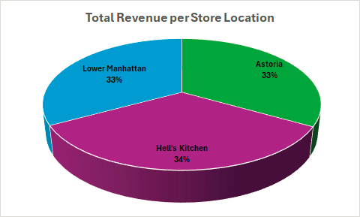
Total Revenue per Store Location
Bright Coffee Shop
Insights
Hell’s Kitchen contributes 34% of total revenue which is the highest share among the three locations.
Astoria and Lower Manhattan each contribute 33%, making them nearly equal in revenue generation..
Summary
The even distribution indicates strong operational performance across store locations, suggesting no major underperforming store.

Slide 6
Total Sales per Month
Bright Coffee Shop
Insights
From February to March there is a slight increase from 10.97% to 14.24%.
March to April sales continued to improvement 16.99%.
April to May there is a noticeable jump to 22.48% which shows the largest monthly growth.
Then May to June shows a smaller rise to 23.71%, suggesting that sales growth is starting to stabilize.
Summary
The business is experiencing strong positive momentum, with more than double the sales share in June compared to February.

Slide 7
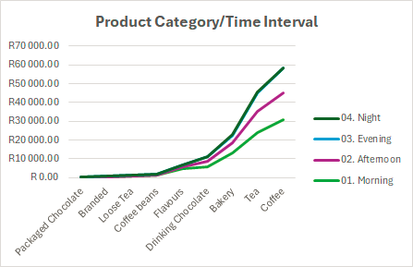
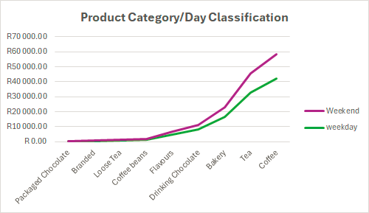
Product Category Time Interval & Day Classification
Bright Coffee Shop
Insights
Most sales are generated during Night and Evening, especially for Coffee and Tea, suggesting customer preference for these beverages later in the day.
Weekends drive significantly higher sales, especially for Coffee, Tea, and Bakery items, indicating strong consumer activity during leisure days.
Summary
Peak sales occur at night and on weekends, driven primarily by Coffee and Tea.

Slide 8
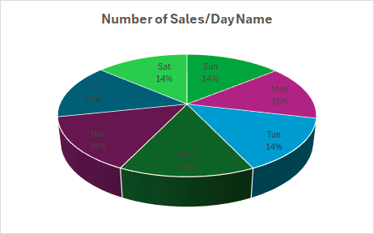
Number of Sales/Day Name
Bright Coffee Shop
Insights
There are no sharp peaks or drops, implying a stable demand pattern without dependence on specific days.
The slight rise on Monday and Friday could be linked to routine workweek patterns.
Summary
Sales are consistently distributed across all days, with Monday and Friday showing marginally higher activity. This steady trend suggests strong and balanced customer engagement throughout the week.

Slide 9
Conclusion
Bright Coffee Shop
Overall revenue and sales have shown consistent growth.
Continue this momentum through seasonal campaigns and customer loyalty programs.
Monitor performance monthly to identify new peaks and dips early.

